Slide 1
The Rasch Model Paradigm
Derek Briggs
EDUC 8720

Slide 2
Overview
Rasch’s motivation and derivation of the model
Model assumptions and properties
Scale Indeterminacy
Specific Objectivity (Activity)
Sense in which Rasch Model provides an interval scale
Rasch Paradigm vs. Lord-Birnbaum Paradigm

Slide 3
Rasch’s Derivation of the Model

Slide 4
An analogy to measurement in the physical sciences
David Andrich on the Rasch Model paradigm:
“It is used when the measurement of the kind used in the physical sciences would be desirable, but no such relevant measuring instrument exists. The prototype of measurement is the partitioning of a continuum, abstracted as the real number line, by equidistant thresholds sufficiently fine that their own width can be ignored, and the location of an entity or object on this line can be measured with the use of the instrument. The location of the entity or object, typically called the measurement, is the number of thresholds exceeded by the object from the origin, and is defined in the unit of the common distance between the thresholds.” (Andrich, 1995, 101)

Slide 5
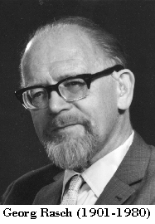
Georg Rasch
Probabilistic Models for Some Intelligence and Attainment Tests (1960, pp. 4-5)

Slide 6
Rasch’s Motivating Context
A group of students (struggling academically) in grades 3-7 attend “special reading classes”.
We wish to evaluate “the benefit these pupils may have drawn from this sort of education.”
Students are given reading tests “before and after the transfer to reading classes.”
“Now, of course the tests used changed from one occasion to another, but nonetheless our aim was to evaluate the progress of each pupil.”
What do we do?

Slide 7
The Design
Test | Grade
 | 3 | 4 | 5 | 6 | 7
1 | X
2 | X |  | X
3 |  | X | X | X
4 |  | X | X | X | X
5 |  |  |  | X | X
What Rasch needed was a way to legitimately compare the reading ability of students in different grades who may or may not take the same reading tests.
What was required are tests that we would today refer to as “vertically equated” or “vertically scaled”

Slide 8
Poisson Distribution
Tells us the probability of a number of events occurring in a fixed period of time if these events occur with a known average rate and independently of the time since the last event:
x is the number of occurrences of an event
λ is a positive real number, equal to the expected number of events that occur during the given interval.
(For instance, if the events occur on average every 4 minutes, and you are interested in the number of events occurring in a 10 minute interval, λ = 10/4 = 2.5. )
Notes:
The number of spelling mistakes one makes while typing a single page.
The number of phone calls at a call center per minute.
The number of times a web server is accessed per minute.

Slide 9
Example of a Poisson PDF
A sample of students participates in a test of reading accuracy
Each student gets the same reading passage.
It turns out that averaged across all students, the average count of words read incorrectly is 10. So λ = 10.
What is the probability that a student reads 4 words incorrectly?

Slide 10
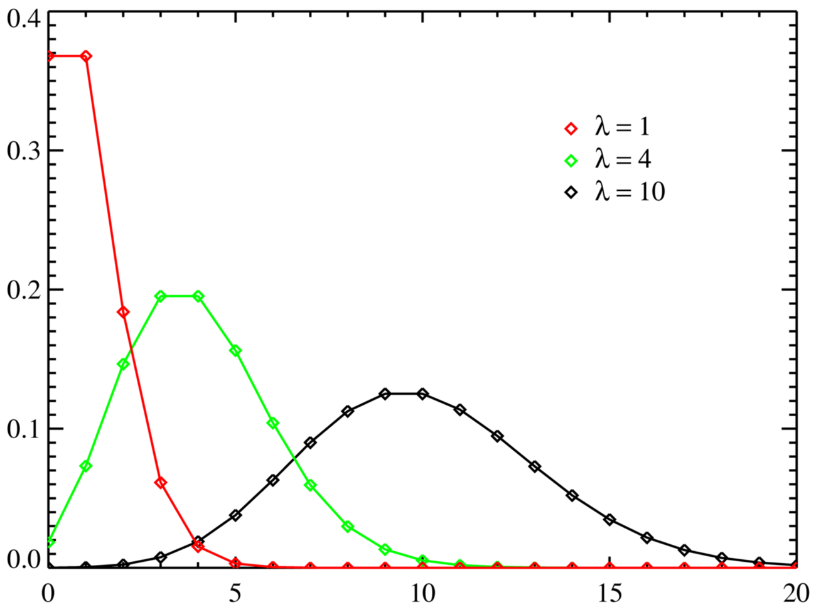
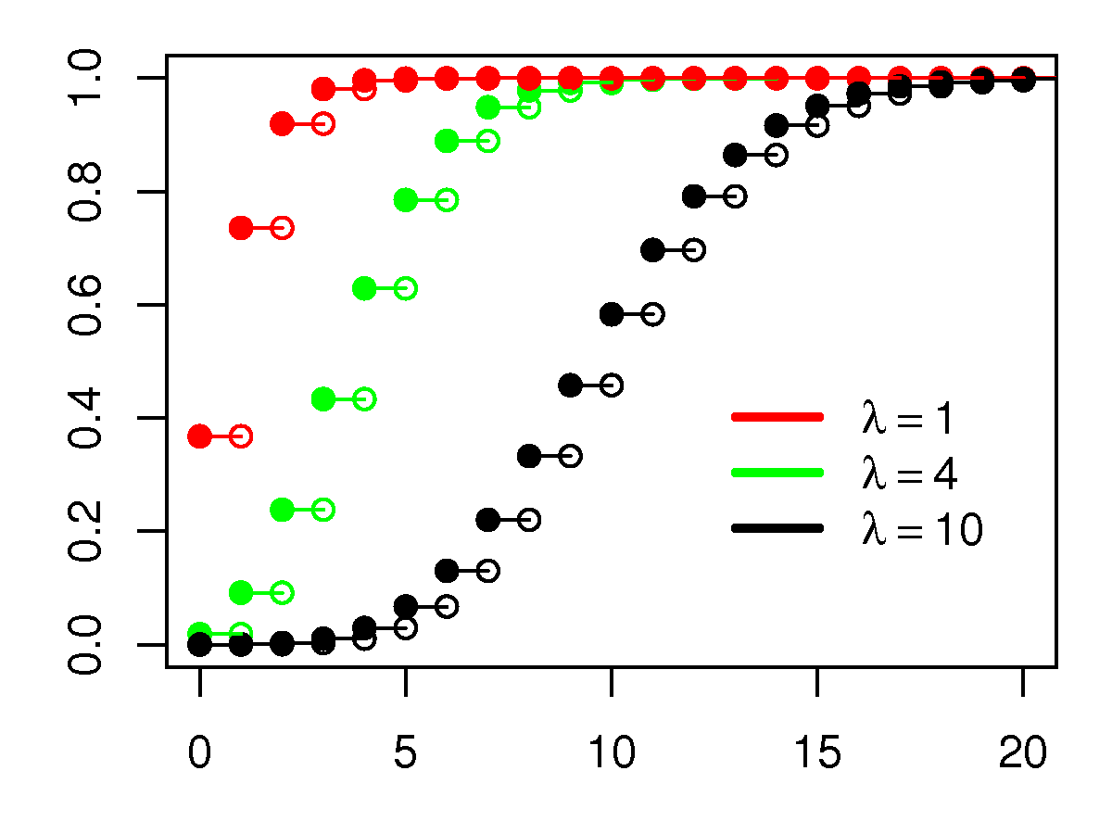
Plots of Poisson PDF & CDF
P(X = k)
P(X < k)

Slide 11
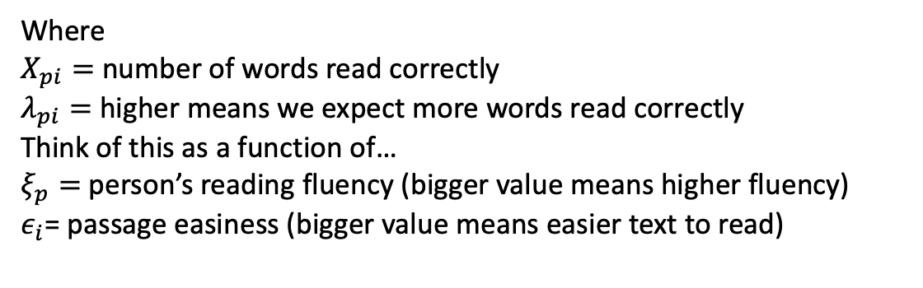
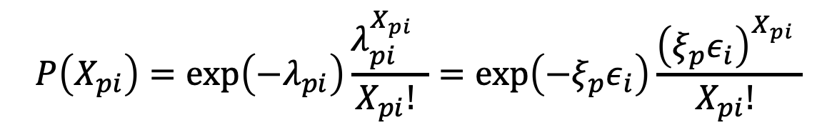
Rasch’s Use of the Poisson in Context of a Test of Reading Speed (i.e., Fluency)
$$P\left(X_{pi}\right)=\exp\left(−λ_{pi}\right)\frac{λ_{pi}^{X_{pi}} }{X_{pi}! }=exp⁡\left(−ξ_{p}ε_{i}\right)\frac{{\left(ξ_{p}ε_{i}\right)}^{X_{pi}} }{X_{pi}! }$$
Where
$X_{pi}=$ number of words read correctly
$λ_{pi}=$ higher means we expect more words read correctly
Think of this as a function of…
$ξ_{p}=$ person’s reading fluency (bigger value means higher fluency)
$ε_{i}$= passage easiness (bigger value means easier text to read)

Slide 12

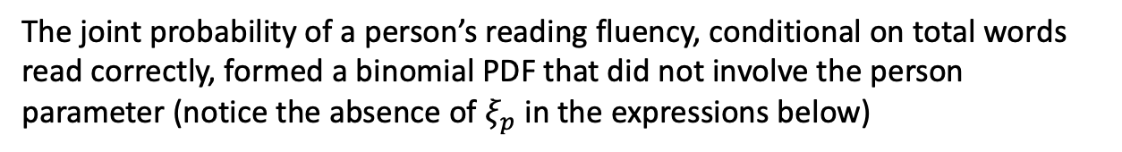
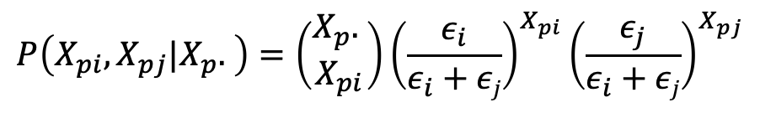

What Rasch Noticed
Let’s say the same person (p) reads two different passages (passage i and passage j) that differ in their difficulty (one is longer than other other, or contains more challenging words)
$$P\left(X_{pi}\right)=\frac{{\left(ξ_{p}ε_{i}\right)}^{X_{pi}} }{X_{pi}! }exp⁡\left(ξ_{p}ε_{i}\right)$$
$$P\left(X_{pj}\right)=\frac{{\left(ξ_{p}ε_{j}\right)}^{X_{pj}} }{X_{pj}! }exp⁡\left(ξ_{p}ε_{j}\right)$$
The joint probability of a person’s reading fluency, conditional on total words read correctly, formed a binomial PDF that did not involve the person parameter (notice the absence of $ξ_{p}$ in the expressions below)
$$P\left(X_{pi},X_{pj}|X_{p}. \right)=\left(\begin{matrix}X_{p}. \\ X_{pi}\end{matrix}\right){\left(\frac{ε_{i}}{ε_{i}+εj}\right)}^{X_{pi}}{\left(\frac{ε_{j}}{ε_{i}+εj}\right)}^{X_{pj}}$$
This meant it was possible to completely separate text parameters from person parameters, and in this sense, the measurement of text difficulty does not depend on the reading fluency of the person and vice-versa.
Notes:
This can be found in Rasch (1960/1980) p. xvii-xviii

Slide 13

Applying this to dichotomously scored intelligence test items…
Rasch: “The simplest function I know of” (logistic)
$$P\left(+ | ξ_{p}{,ε}_{i}\right)=\frac{ξ_{p}ε_{i}}{1+ξ_{p}ε_{i}}$$
Where “+” was the symbol Rasch used for a correct item response. This was the original expression for what we now call the Rasch Model. It shares the same property of separability for its two parameters with the multiplicative Poisson.

Slide 14


The Modern Formulation
The present day expression known as the Rasch Model follows from a monotonic (“order preserving”) transformation to both person ability and item difficulty parameters
$${θ_{p}=ln⁡(ξ}_{p})$$
$β_{i}=ln⁡(ε_{i}$)
$$P\left(X_{pi}=1 | θ_{p},β_{i}\right)=\frac{exp⁡(θ_{p}−β_{i})}{1+exp⁡(θ_{p}−β_{i})}$$

Slide 15
Model Assumptions and Properties

Slide 16
Rasch Model Assumptions
Unidimensionality: A collection of items (i.e., a test) have been designed to measure one latent construct.
Local (Conditional) Independence: Conditional on the latent construct, item responses within any given respondent are independent.
Functional Form: The probability of a correct response to an item is a logistic function of a person parameter (“ability”) and just one item parameter (“difficulty”)
Continuous Quantitative Variable: The underlying latent construct of measurement is a continuous quantity.

Slide 17
Rasch Model Properties
Parameter Invariance: If the model fits, item & person parameters should be the same regardless of the group of persons & items used to estimate them.
Scale Indeterminacy: The logit scale is only identified up to a linear transformation. This means it needs to be “anchored”.
Sufficiency and separability: We can estimate item difficulty without including person ability and vice-versa.
Specific objectivity: Invariant comparisons among persons and items.
Interval Scale: An argument can be made that the logit scale of the Rasch Model has a well-defined common unit for an interval scale.

Slide 18
Scale Indeterminacy: Choosing an “Anchor”

Slide 19
Indeterminacy of the Logit Scale
The IRT score scale is expressed in terms of logit values.
Identification problem: on the right hand side of the equation, you have three unknown parameters. Say the left hand side (log of the odds, i.e., logit) = 1.5
All of the following would be admissible values for person and item parameters
 | 3 | 2 | 1 | -1
 | 1.5 | .5 | -.5 | .25
 | 1 | 1 | 1 | 2

Slide 20
“Anchoring” the Scale
Two things need anchoring: location of scale, variability of scale.
Two choices: anchor (e.g., constrain) the item parameters OR the person parameters.
ITEM SIDE (Rasch Tradition)
Set mean of item difficulty to be 0, common discrimination =1
Mean and SD of person distribution are free to vary.
PERSON SIDE (Lord-Birnbaum Tradition, Thurstone)
Set mean of person proficiency to be 0, SD =1
Mean of item difficulty and values of item discrimination parameters free to vary

Slide 21
Specific Objectivity

Slide 22
Specific Objectivity
Comparisons between objects must be generalizable beyond the specific conditions under which they were observed.
Rasch (1960, 1967):
Comparisons between persons are invariant over the specific items used to measure them.
Comparisons between items are invariant over the specific persons used to calibrate them.
Rasch was actually a bit vague about this concept, and the extent to which it was different from the more general IRT property of parameter invariance.
Specific objectivity in the Rasch Model can be seen a consequence of two other features that are specific to estimation of the model’s parameters: sufficiency and separability. I’ll focus on the feature of separability in what follows.

Slide 23
Activity

Slide 24
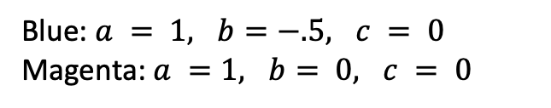
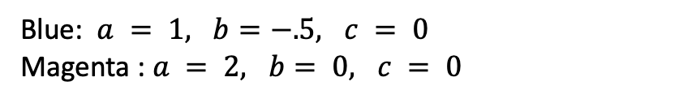
IRFs for 2PL vs. Rasch Model for Two Items
Blue: $a = 1, b=−.5, c = 0$
Magenta : $a = 2, b= 0, c = 0$
Blue: $a = 1, b=−.5, c = 0$
Magenta: $a =1, b= 0, c = 0$

Slide 25


IRFs with Outcome Switched from Probability to Logit (log odds) of Correct Item Response
$$a_{i}(θ_{p}−b_{i})$$
$$1(θ_{p}−b_{i})$$

Slide 26
Compare Two Pairs of students relative to predicted performance on each item based on the 2PL
Student | Theta | P(item 1 is correct) | Log Odds item 1 is correct | P(item 2 is correct) | Log Odds item 2 is correct
Larry | -0.5
Kevin | -1.0
Difference | 0.5
Student | Theta | P(item 1 is correct) | Log Odds item 1 is correct | P(item 2 is correct) | Log Odds item 2 is correct
Celia | 1.5
Temple | 1.0
Difference | 0.5
2PL item parameters→ Item 1 (blue ICC) a = 1, b = -.5 Item 2 (magenta) a = 2, b = 0.

Slide 27
Compare Two Pairs of students relative to predicted performance on each item based on the 2PL
Student | Theta | P(item 1 is correct) | Log Odds item 1 is correct | P(item 2 is correct) | Log Odds item 2 is correct
Larry | -0.5 | .50 | 0 | .27 | -1
Kevin | -1.0 | .38 | -.5 | .12 | -2
Difference | 0.5 | .12 | .5 | .15 | 1
Student | Theta | P(item 1 is correct) | Log Odds item 1 is correct | P(item 2 is correct) | Log Odds item 2 is correct
Celia | 1.5 | .88 | 2 | .95 | 3
Temple | 1.0 | .82 | 1.5 | .88 | 2
Difference | 0.5 | .06 | .5 | .07 | 1
2PL item parameters→ Item 1 (blue ICC) a = 1, b = -.5 Item 2 (magenta) a = 2, b = 0.

Slide 28
Now do the same thing relative to performance on each item as predicted based on the Rasch Model
Student | Theta | P(item 1 is correct) | Log Odds item 1 is correct | P(item 2 is correct) | Log Odds item 2 is correct
Larry | -0.5
Kevin | -1.0
Difference | 0.5
Student | Theta | P(item 1 is correct) | Log Odds item 1 is correct | P(item 2 is correct) | Log Odds item 2 is correct
Celia | 1.5
Temple | 1.0
Difference | 0.5
Rasch item parameters→ Item 1 (blue ICC) a = 1, b = -.5 Item 2 (magenta) a = 1, b = 0.

Slide 29
Now do the same thing relative to performance on each item as predicted based on the Rasch Model
Student | Theta | P(item 1 is correct) | Log Odds item 1 is correct | P(item 2 is correct) | Log Odds item 2 is correct
Larry | -0.5 | .50 | 0 | .38 | -.5
Kevin | -1.0 | .38 | -.5 | .27 | -1
Difference | 0.5 | .12 | .5 | .11 | .5
Student | Theta | P(item 1 is correct) | Log Odds item 1 is correct | P(item 2 is correct) | Log Odds item 2 is correct
Celia | 1.5 | .88 | 2 | .82 | 1.5
Temple | 1.0 | .82 | 1.5 | .73 | 1.0
Difference | 0.5 | .06 | .5 | .09 | .5
Rasch item parameters→ Item 1 (blue ICC) a = 1, b = -.5 Item 2 (magenta) a = 1, b = 0.

Slide 30
Questions
For each model (2PL, Rasch)
What do you notice about the differences in probabilities of correct item responses for
the same item across different student pairings, and
the same student pairing across different items?
What do you notice about the differences in the logit of correct item responses for
the same item across different student pairings, and
the same student pairing across different items?

Slide 31
Invariant Person Comparisons
RASCH MODEL
Comparison only depends on ability of two respondents-- item difficulty drops out of eqn.
2PL MODEL
Comparison depends on both ability of two respondents, and discrimination of the item.

Slide 32
Invariant Item Comparisons
RASCH MODEL
Comparison only depends on difficulty of items, person ability drops out of eqn.
2PL MODEL
Comparison depends on person ability, as well as difficulty & discrimination of the items.

Slide 33
Sense in which Rasch Model provides an interval scale

Slide 34
Interval Scale as Item to Person Tradeoffs
Each blue line represents a unique item, the highest curve is the easiest item, lowest curve is most difficult, each item differs in difficulty by .5 logits ranging from -4 to 4.
Notes:
The horizontal dashed line at a logit value of 1 is there to illustrate the idea that if you want to maintain the same log odds of a correct response as theta goes from low to high, then you need to move to a new blue line (representing a new item). So the interval of the scale can be defined by a reference distance between items that becomes the unit in which tradeoffs between ability and difficulty are understood. Notice that the distance from theta = -1 to 0 is defined by moving down two items (blue lines) to maintain the same logit. That’s also true if we go from 0 to 1!

Slide 35
Theoretical Basis for a Reference Unit
Build fractions from unit fractions
[GRADE 4]
CCSS.MATH.CONTENT.4.NF.B.3.C Add and subtract mixed numbers with like denominators
Use equivalent fractions as a strategy to add and subtract fractions. [GRADE 5]
CCSS.MATH.CONTENT.5.NF.A.1 Add and subtract fractions with unlike denominators (including mixed numbers)

Slide 36
Hypothetical Example
Students
Logits
Reference Items
.50
.25
Scott Grade 5
0
Gain = 0.25 logits
Scott Grade 4
-.25
.50

Slide 37
Establishing a Standard Unit for Growth
Students
Logits
Reference Items
Enis Grade 5
.50
.25
Enis Grade 4
Gain = 0.5 logits
Scott Grade 5
0
Gain = 0.25 logits
Scott Grade 4
-.25
.50
Notes:
For ANY student we could say that an gain of .5 logits is equivalent to the growth that would be needed to go from a key grade 4 reference item to a key grade 5 reference item.

Slide 38
The Value of Invariant Comparisons
If data fits the Rasch Model, then
The magnitude of growth from grade 4 to 5 for each student has the same magnitude no matter what item (or item difference) is used as a frame of reference, because when logits are subtracted
Expected growth can be defined by differences in reference item locations, and this does not vary by initial ability of student.

Slide 39
What Happens Under the 3PL?
Difference across People are Item Specific
Differences in Item Locations are Person Specific

Slide 40
Rasch Paradigm “vs.” Lord-Birnbaum Paradigm

Slide 41
Defining Features of Rasch Paradigm
Strong focus on scale properties, understanding distances along the scale with respect to item locations, unit of measurement
Ex: item mapping (e.g., Wright Maps) see Briggs (2019)
Specific Objectivity: invariance of person and item comparisons
Requires iteration between theory, instrumentation and mathematical modeling
If item doesn’t fit the model, we need to understand why.

Slide 42
Comparing the Paradigms
Lord-Birnbaum Paradigm
Rasch
Key problem to be solved with tests: to rank and classify (e.g., admission to college, earning a scholarship, job certification)
Motto: Choose the model that best fits the data
Pattern scores
Highly practical—doesn’t require strong theories linking construct to item design.
Key problem to be solved with tests: to express differences of magnitude (e.g., how much has a student grown? How much more has group A learned compared to group B?)
Motto: Design a test so/until it shows adequate fit to the model
Sum scores
Strive for parsimony
Invariance is key to both paradigms, it is simply a more stringent form in the Rasch Model.

Slide 43
Some Last Thoughts on Rasch Paradigm
Scale properties matter (even if this seems invisible to us as researchers)! See, for example ER, pp. 152-156.
If the goal is to measure growth with respect to magnitude (how MUCH), then it seems critical to have an interval scale, and its seems important to have test items that fit the RM.
But if the goal is to use a test to rank and classify, and if this is to be done under the time-sensitive constraint of a bank of items, then more complex IRT models make it easier to design tests that can maximize classification accuracy and consistency.
The RM is no panacea. (1) only requires constant discrimination, not high discrimination (2) require theories that explain variability in both item difficulty and person ability in terms of manipulable design features. These are in short supply!

Slide 44
Extra

Slide 45
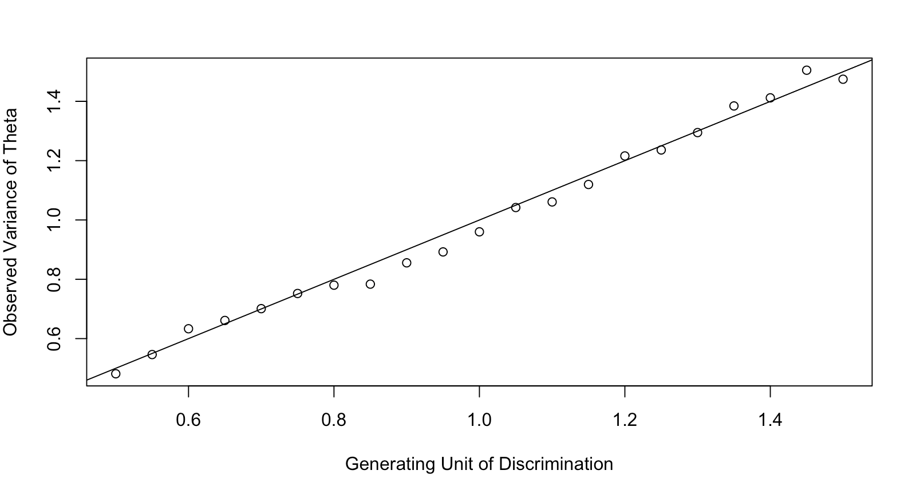
Discrimination and Variance of Theta are Two Sides of the Same Coin
Simulation:
Generate 500 by 25 item response matrices from (1) a std normal theta distribution, with (2) uniform item difficulty distribution from -3 to 3 in .25 increments.
For each matrix, let the value of the common discrimination parameter range from .5 to 1.5 in increments of .05
Upshot: If $α$ is constrained to be 1, the ability of the instrument to discriminate between respondents will be evident in the variability of theta.

Slide 46
There are many ways to express the same model mathematically
How many distinct ways can you come up with to write out an expression for the Rasch Model?
Try this before going on the next slide…

Slide 48
There are two differences between these equations:
In the second equation, we assume implicitly the discrimination parameter (“alpha”) equals 1, in the first eqn we just assume it is the same for all items.
In the second equation, the probability of a correct response is in terms of latent proficiency and item “easiness”

Slide 49
This is a more general way to write an expression that represents the ICC for either response scenario: x=1 when response is correct, x=0 when incorrect. Note that exp(0)=1.
Here we’ve changed our dependent variable (left side of the eqn) from probability to log odds (i.e., logits). As you can see, logits are a linear function of “theta” and “beta”.

Slide 50
This expression is mathematically equivalent to the one with exp(..) in the numerator and denominator. It’s a little more elegant to write this way, but it threw me for a loop the first time I saw it.
Here we’ve changed our dependent variable from probability to odds without taking the log of both sides. As you can see, the odds an be expressed as the ratio of theta and beta.

Slide 51
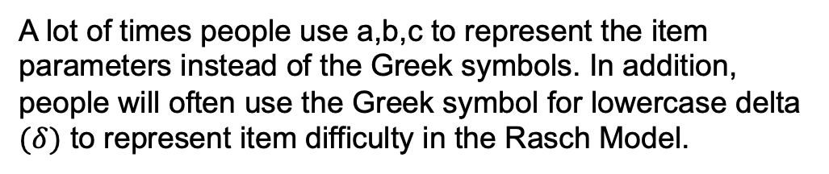
The only unique thing here is including the constant D (=1.7), which places the logistic ICC on the same scale as the normal ogive ICC.
A lot of times people use a,b,c to represent the item parameters instead of the Greek symbols. In addition, people will often use the Greek symbol for lowercase delta $(δ)$ to represent item difficulty in the Rasch Model.

Slide 52
Recall: The Normal Ogive
Going from logistic function to the normal ogive, also known as the standard normal cumulative distribution function (cdf).
The symbol “Phi” is a shorthand way to represent the normal cdf formulation above.

